Slide 1
Advanced operating System
Unit-1
Introduction to operating System

Slide 2
Computer System Structure
Computer system can be divided into four components:
– Hardware – provides basic computing resources
• CPU, memory, I/O devices
– Operating system
• Controls and coordinates use of hardware among various applications and users
– Application programs – define the ways in which the system resources are used to solve the computing problems of the users
• Word processors, compilers, web browsers, database systems, video games
– Users
• People, machines, other computers

Slide 3
Computer System Structure

Slide 4
What is an operating system?
An operating system (OS) is a collection of system programs that together control the operation of a computer system.
An operating system is a program that act as interface between the user and computer hardware and controls the execution of all kinds of program
An operating system is a software which performs all the basic task like process management, memory management, file management, handling input and output and controlling peripheral devices.
Some popular operating system include Linux, windows, unix, os/400 etc.

Slide 5
Operating system goals:
To make a computer user friendly.
Proper utilization of computer resources.
To hide the details of the hardware resources from the users.
To provide users a convenient interface to use the computer system.
Provides an environment within which other programs can do useful work.
Objective of OS
Tow main objective of operating system use are:
OS as an Extended Machine
OS as a Resource Manager

Slide 6
OS as an Extended Machine
The computer system is composed of hardware and application software interacting with each other to perform any computation
For any application to perform its task, it must deal with hardware for memory management, process control, storage and so on.
But for a programmer, it would be tedious to consider the hardware level machine language programming for each application development.
Operating system provides the high-level abstraction to deal with such issues.
Operating system provides a set of programs that handles the complex hardware level programming and provides the programmer an easy interface to develop application without hardware consideration.
For eg: consider the case of disks. A disk contains collection of files. Each file can be opened, read, written and closed. The hardware details like if recording should use modified FM or the current state of motor, etc. are masked by OS and also handled effectively.

Slide 7
OS as a Resource Manager
A computer system is a system with various resources like memory processor, disk, printer, etc.
It is necessary to keep track of the resource allocation and usage in order to resolve conflict between two or more processes for allocation of same resources.
So, the need of managing memory and resources among the processes or the users is necessary.
OS keeps track of current usages status of resources, who is using resource, to grant resource request if available and so on.
Eg. If 3 programs are requesting for a printer service the OS schedule the tasks based on priority. It can be managed by buffering all the output destined for the printer on disk

Slide 8
OS evolution
Computer Generation, Component and OS Types
1st (1945-55) Vacuum Tubes User Driven
2nd (1955-65) Transistor Batch
3rd (1965-80) IC Multiprogramming
4th (1980-present) PC Client Server/Distributed

Slide 9
Operating-System Operations
OS must ensure that an incorrect program can not cause other programs to execute incorrectly, and must terminate the such erroneous program
Provide hardware support to differentiate between at least two modes of operations
User mode : execution done on behalf of a user. User programs runs in user mode, which permits only the subset of instructions to be executed and subset of features to be accessed.
Kernel mode (or supervisor mode) : execution done on behalf of operating system.
OS runs in kernel mode, giving it access to the complete hardware.
Mode bit is added to the hardware of the computer to indicate the current mode: kernel(0) and user(1).

Slide 10
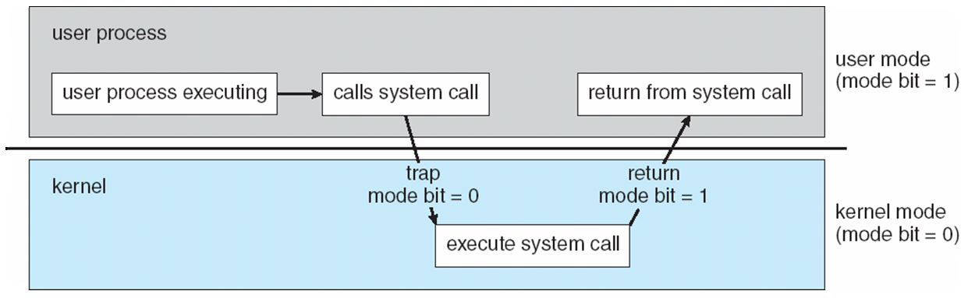
When an trap or interrupt occurs hardware switches from user mode to the kernel mode. Thus, whenever the OS gains control of computer, it is in kernel mode. The system always switches to user mode before passing control to the user program.
Privileged instructions can be issued only in kernel mode.

Slide 11
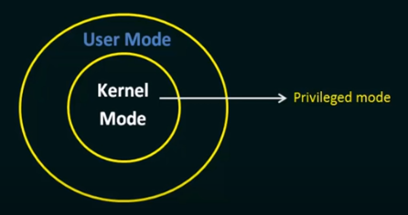
System Call
System call provide an interface to the services made available by an operating system.
System call is the programmatic way in which a computer program request a services from the kernel of operating system
These calls are basically available as routines written in c and c++.
System calls are the only entry points for the kernel system.

Slide 12
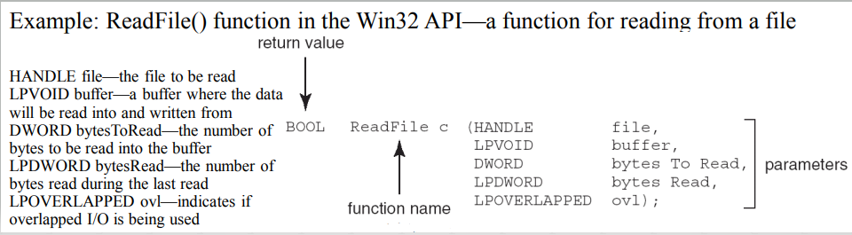
Mostly accessed by programs via a high-level Application Program Interface (API) rather than direct system call use
Three most common APIs are Win32 API for Windows, POSIX API for POSIX-based systems (including virtually all versions of UNIX, Linux, and Mac OS X), and Java API for the Java virtual machine (JVM)

Slide 13
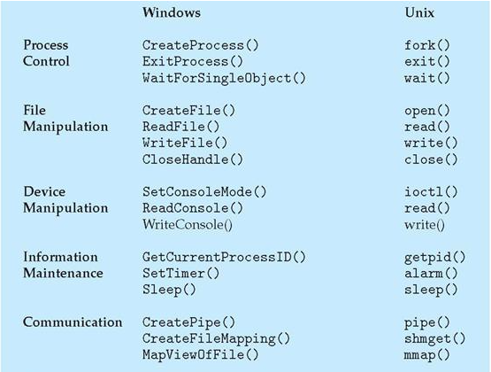
Example of Windows and UNIX System Call

Slide 14
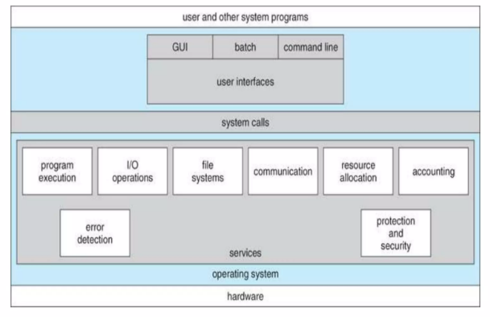
Operating System Services

Slide 15
User Interfaces: Means by Which user can issues command to the system. Depending on the system these may be a command-line interface, GUI interface, or a batch command systems.
Program Execution: The OS must be able to load program into RAM, run the program, and terminate the program, either normally or abnormally.
I/O Operations: The operating system is responsible for transferring data to and from I/O devices, including keyboards, terminal, printers and storage devices.
File-System Manipulation: In addition to row data storage, The operating system is also responsible for maintaining directory and sub directory structures.
Communications: Inter-Process communications, IPC either between processes running on the same processor, or between processes running on separate processors or separate Machines.
Error Detection: Both hardware and software errors must be detected and handled appropriately.
Resource Allocation: E.g CPU cycles, main memory, storage spaces and peripheral devices.
Accounting: Keeping track of system activity and resources usage.
Protection and security: Preventing harm to the system and to resources, either through wayward internal processes or malicious outsiders.

Slide 16
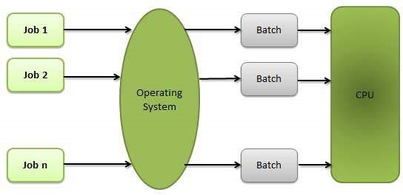
Types of Operating System
Batch OS:
The users of a batch operating system do not interact with the computer directly.
Each user prepares his job on an off-line device like punch cards and submits it to the computer operator.
To speed up processing, jobs with similar needs are batched together and run as a group.
A job gets assigned to the CPU, only when the execution of the previous job completes.
E.g. Payroll System, Bank Statements etc.

Slide 17
Interactive System:
The user can interact directly with OS to supply commands and data as applications program executes.
The user receives the output immediately.
There is direct too way communication between user and computer.
A user interface is provided which may be command line or GUI.
Example : Mac and Windows etc
Time- Sharing System(Multitasking)
The processor’s time is shared among multiple users simultaneously.
The main objective is to tasks by switching.
It reduces CPU idle time.
Example : Multics, Unix etc.

Slide 18
Multiprogramming OS
Multiple jobs in memory at the same time
Each memory space protected from each other. OS picks one, execute it for a while, stops (e.g.when programs reads for input or randomly), picks other to run..
Single user cannot keep CPU and I/O devices busy at all times
One job selected and run via job scheduling
When it has to wait (for I/O for example), OS switches to another job
Distributed OS
This type of OS is designed to share its work load over multiple servers.
Thus it has a decentralized architecture.
It shares data and resources among its multiple server to get maximum efficiency
Example: unix, Linux,X/open etc

Slide 19
Real time OS
Real-Time OS are usually built for dedicated systems to accomplish a specific set of tasks within deadlines.
Hard Real Time :
In Hard RTOS, the deadline is handled very strictly which means that given task must start executing on specified scheduled time, and must be completed within the assigned time duration.
Example: Medical critical care system, Aircraft systems, etc.
Soft Real Time:
In this type of RTOS, there is a deadline assigned for a specific job, but a delay for a small amount of time is acceptable. So, deadlines are handled softly by this type of RTOS.
Example Online Transaction system and Livestock price quotation System.

Slide 20
Introduction to Operating System Structure
A structure of an Operating System determines how it has been designed and how it functions.
The structure of the OS depends mainly on how the various common components of the operating system are interconnected and melded into the kernel
There are numerous ways of designing a new structure of an Operating system
The most common structures of operating System are
Layered system
Kernel system
Client-server model
Virtual machine

Slide 21
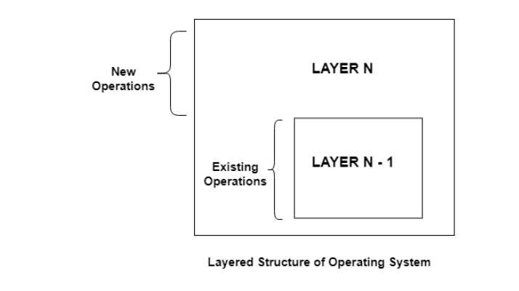
Layered System
The operating system is divided into a number of layers (levels), each built on top of lower layers.
The bottom layer (layer 0), is the hardware; the highest (layer N) is the user interface
With modularity, layers are selected such that each uses functions (operations) and services of only lower-level layers.

Slide 22
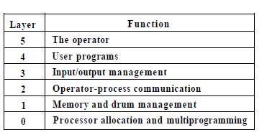
A layered design was first used in THE operating system. Its six layers are as follows
Layer 0 was responsible for the multiprogramming aspect of operating system. It decided which process was allocated to CPU.
It dealt with interrupts and performed the context switch when process change was required.
Layer 1 was concerned with allocating memory to process.
Layer 2 deals with inter-process communication and communication between operating system and the console.

Slide 23
Layer 3 manages all I/O between device attached to the computer. This included buffering information from the various devices.
Layer 4 The programs used by the user are operated in this layer, and they don’t have to worry about I/O management, operator/processes communication, memory management, or the processor allocation.
Layer 5 The system operator process is located in the outer most layer.
This system operator controls overall of the system.

Slide 24
Kernel System
Kernel is core component of Operating system without which OS can not work.
Kernel is nervous system of OS
It is central component of operating system that manages operation of computer and hardware.
It basically manages operation of memory and CPU time.
Kernel acts as a bridge between applications and data processing performed at hardware level using inter-process communication and system calls.
Kernel uses the system call to prepare all its function like CPU scheduling, memory management etc.

Slide 25
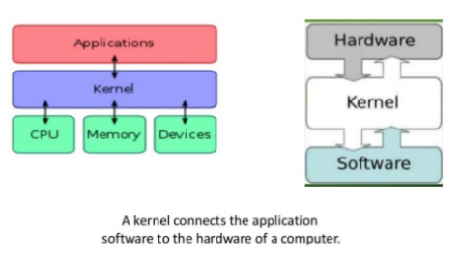
The main function of kernel are:
It provides mechanism for creation and deletion of processes.
It provides CPU scheduling, memory management and I/O management.
It provides mechanism for inter-process communications

Slide 26
Types of kernel
There are mainly two types of kernel.
Monolithic/Macro kernel
Micro / Exo-kernel
Monolithic/Macro kernel:
It is traditional or older approach of kernel deign.
In monolithic kernel every basic system series like process and memory management, interrupt handling and I/O communication, file system run in kernel space.
Every component of operating system is contained in the kernel and can directly communicate with each other by using function call.
Kernel typically executes with unrestricted access to the computer system
This approach provides rich and powerful hardware access.
Ex: Linux, UNIX, open VMS etc.

Slide 27
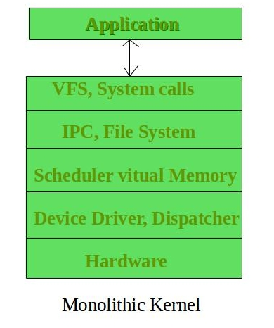
Advantage:
The execution of monolithic kernel is quite fast.
Smaller in source and compile forms.
System call are used to do operation
Less code generally means fewer bugs and security problem is also less.
Disadvantage:
Coding in kernel space is hard.
Debugging is harder.
Monolithic kernel must be written for each new architecture that the OS to be used.

Slide 28
Micro / Exo-kernel
In a microkernel, the kernel provides basic functionality such as IPC, memory management and scheduling etc that allows execution of server and separate program.
The kernel is broken into separate processes known as server. Some of server run in user space and some in kernel space.
The communication in microkernel is done via message passing. The server communicate through Interprocess communication.
Server invoke “services” from each other by sending message.
If a service fails , the rest of OS work fine.

Slide 29
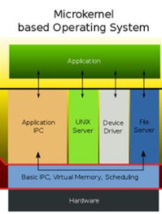
Advantage:
Smaller in size.
Easy to maintain
New services can be added easily.
Portable.
Crash resistant.
Disadvantage
Service provided by microkernel is expensive.
Execution is slow.

Slide 30
Client server Model
One of the recent advances in computing is the idea of a client/server model .
A server provides services to any client that requests it.
This model is heavily used in distributed systems where a central computer acts as a server to many other computers.
In this model, kernel handles the communication between the client and servers.
operating system (OS) is splitting up into parts, each of which only handles one fact of the system, such as file service, terminal service, process service, or memory service, each part becomes small and manageable.

Slide 31
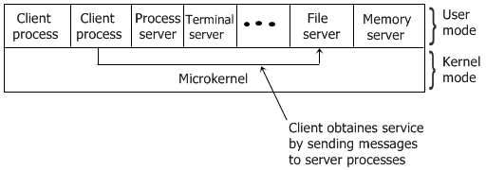
Advantage:
It can result in a minimal kernel.
it’s adaptability to user in distributed system
Crash resistant.
Disadvantage:
Security problem
overloading

Slide 32
Virtual machine
Virtual machine is an illusion of a real machine.
It is created by a real machine operating system, which make a single real machine appears to be several real machine.
Actually, virtual machine can run several operating systems at once, each of them on its virtual machine.
A virtual machine provides an interface identical to underlying bare hardware.
The operating system creates illusion of multiple processes, each executing on its own processor with its own memory.
The resource of the physical computer are shared to create virtual machine.

Slide 33
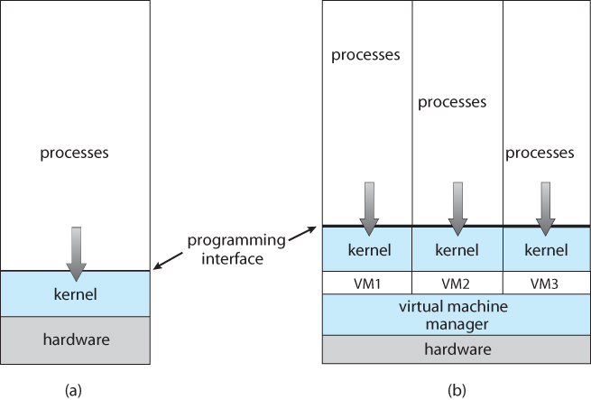
Advantage:
Provides a robust level of
Security.
Allows multiple OS to run
On same machine at same
Time
Easier to system upgrade.
Disadvantage:
Less efficient.
Difficult in sharing of hard drives
Non Virtual machine
Virtual machine

Slide 34
Distributed Systems
A distributed system is a collection of physically separate, possibly heterogeneous, computer systems that are networked to provide the users with access to the various resources that the system maintains.
Access to a shared resource increases computation speed, functionality, data availability, and reliability
Network Operating System provides features between systems across network
– Communication scheme allows systems to exchange messages
– Illusion of a single system

Slide 35
Concurrency
Concurrency in operating systems refers to the ability of an operating system to handle multiple tasks or processes at the same time.
With the increasing demand for high performance computing, concurrency has become a critical aspect of modern computing systems.
Operating systems that support concurrency can execute multiple tasks simultaneously, leading to better resource utilization, improved responsiveness, and enhanced user experience
It is used in a wide range of applications, including web servers, databases, scientific simulations, and multimedia processing.
However, concurrency also introduces new challenges such as race conditions, deadlocks, and priority inversion, which need to be managed effectively to ensure the stability and reliability of the system.

